Slide 1
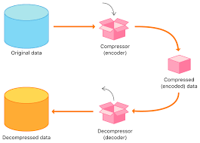
Compression

Slide 2

Objectives
Students should be able to
State what is meant by compression
Outline reasons for compression
Describe the two compression methods
Outline the process of using RLE encoding

Slide 3

What is compression?
A compression technique is an algorithm, i.e. a sequence of steps, that is followed to reduce file size
Compression makes file sizes smaller. Some computer files are very large. if you need to store files on a device with limited capacity (such as a memory card), or transfer the file data over a cable or wireless communications link, large files can be a problem.
A smaller file size means that more files can be stored in a fixed amount of storage, and files will be quicker to transfer, upload, and download.

Slide 4

Compression Ratio
A compression ratio gives an indication of the effectiveness of a compression method in reducing file size.
It measures the reduction in the size of a file as a result of applying a compression algorithm.
It is calculated by dividing the size of the original file by the size of the compressed file.
A higher compression ratio means better compression or a higher percentage of space saved during the compression process.

Slide 5
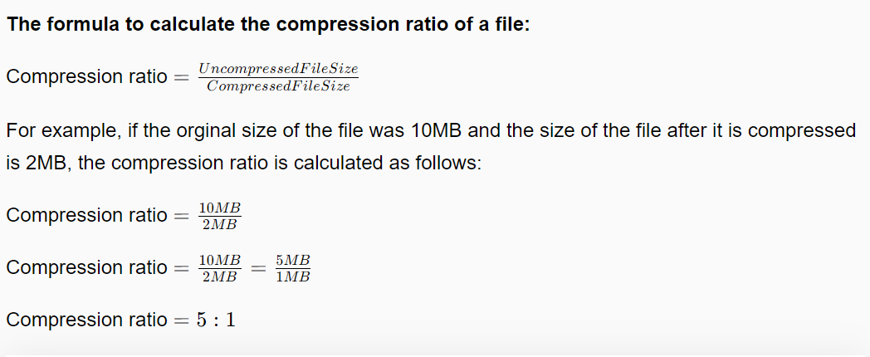
The formula to calculate the compression ratio of a file

Slide 6

Image Compression
Image files can be very large. A typical mid-range camera is rated at 24, this means that the maximum number of pixels used to represent an image is approximately 24,000,000.
The number of bits used per pixel (colour depth) for a photographic image is typically rated at 12 bits per colour channel for red (r), green (g), and blue (b),
(RGB), a total of 36 bits per pixel.

Slide 7
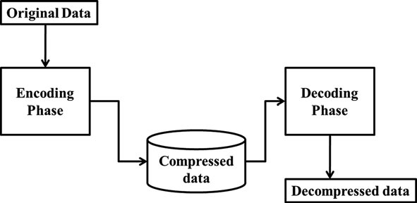
Image Compression
To reduce the storage and transfer time needed, images are commonly stored in JPEG format, which is highly compressed.
JPEG compression will reduce a file to around 10% of its uncompressed size.

Slide 8
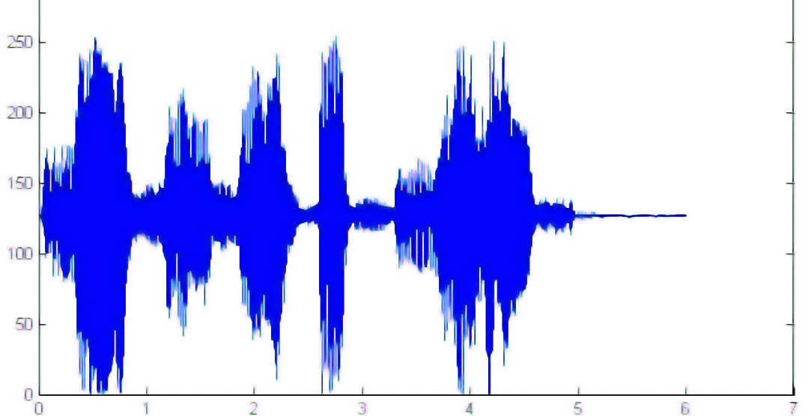
Sound Compression
Sound files can also be very large.
The most popular audio file format is MP3, which is a compressed format.
Most people would not notice the difference in sound quality after compression and would benefit from the reduction in size for streaming or download purposes.
WAV is an uncompressed audio format.

Slide 9
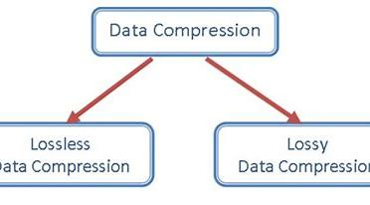
Types of Compression Methods
There are two types of compression that can be applied to files
lossy compression
lossless compression

Slide 10
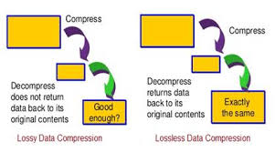
Lossy compression
Lossy compression permanently removes data from the file that the computer believes you can do without (redundant data).
The difference is not easy noted.
It is impossible to get the file back to its original state and quality.
Lossy compression is best at creating really small file sizes – ideal for downloads or streaming.
File formats that use lossy compression include
MP3
MP4
JPG

Slide 11
Lossless
Lossless compression reduces the size of a file without any damage to the file or reduction in quality.
The file can be recompressed to its original state, with all the data bits reconstructed.
Lossless compression is ideal for compressing text or numeric files where a loss of data is unacceptable.
It is also used in PNG, GIF and ZIP files.

Slide 12
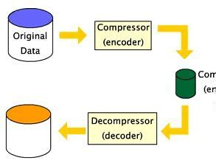
How does lossless compression work?
Lossless compression takes advantage of repetition and patterns.
A compression algorithm is used to find and index repeated words or patterns (or sections of words) within the data.
Wherever they occur in the data, the indexed words/patterns are replaced with numerical values.
The index will need to be stored with the data to allow decompression with no loss of data.

Slide 13
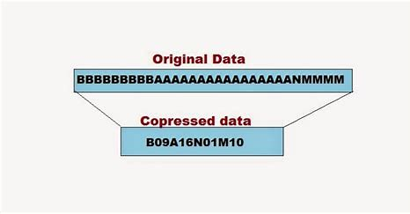
Run Length Encoding (RLE) Compression
A coding scheme that counts the number of similar bits instead of sending them individually.
Coding of data with different numbers of bits. Frequently reoccurring data has the smallest number of bits; data that seldom reoccur have the highest number of bits.
RLE is probably the easiest compression algorithm there is. It replaces sequences of the same data values within a file by a count number and a single value.

Slide 14
How RLE works
Suppose the following string of data (17 bytes) has to be compressed:
ABBBBBBBBBCDEEEEF
Using RLE compression, the compressed file takes up 10 bytes and could look like this:
A *8B C D *4E F
Repetitive strings of data are replaced by a control character (*) followed by the number of repeated characters and the repetitive character itself.
The control character is not fixed, it can differ from implementation to implementation.
If the control character itself appears in the file then one extra character is coded.
RLE encoding is only effective if there are sequences of 4 or more repeating characters because three characters are used to conduct RLE so coding two repeating characters would even lead to an increase in file size.

Slide 15
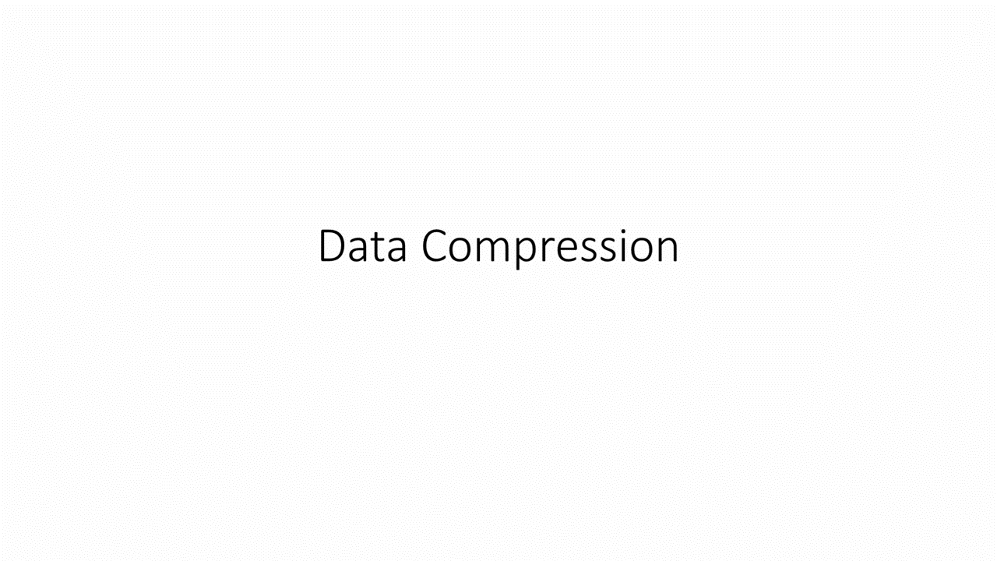
Run Length Coding

Slide 16
How are the various files (text, bitmap, image, vector graphics and sound can be compressed
Text File compression
Bitmap Image compression
Can be compressed using various algorithm
The most common being lossless.
RLE
DEFLATE used in the ZIP format, it combines LZ
Consist of pixel which can be compressed using either lossless or lossy

Slide 17
How are the various files (text, bitmap, image, vector graphics and sound can be compressed
Sound compression
Sound files can be compressed using various techniques, primarily to reduce file size while maintaining acceptable audio quality
Lossless for format like FLAC and ALAC (apple lossless)
Lossy for MP3, ACC and OGG

